Slide 1


DATA221 Intro Machine Learning 02 objective function
William Trimble
Spring 2022

Slide 2
Office hours
Wednesday 2pm (Jiacheng, zoom)
Thursday, 2pm (Sherry, zoom)
Friday 2pm (WT, Crerar )

Slide 3

Caught in the wild!
And for the noble, purpose allowing salespeople to send spam with fewer constraints!
https://www.npr.org/2022/03/27/1088140809/fake-linkedin-profiles

Slide 4
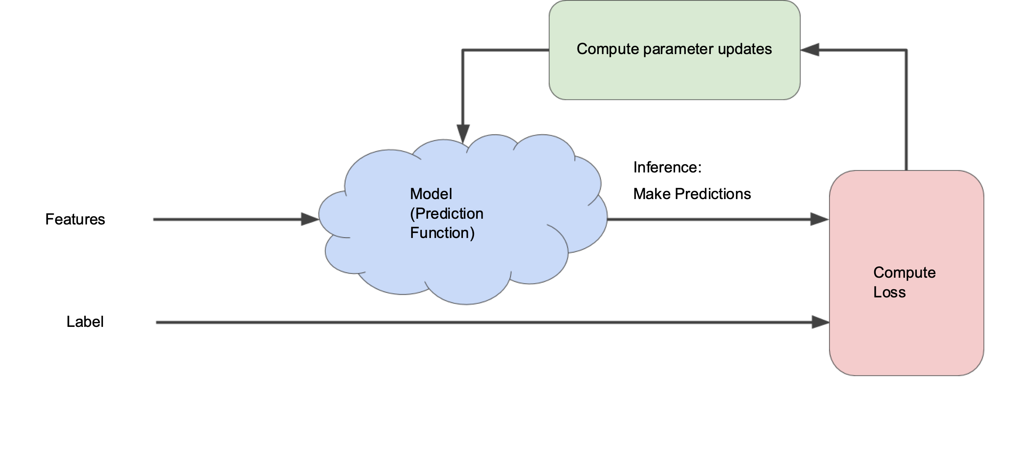
Fairy dust picture of optimization

Slide 5
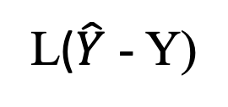

Fairy dust picture of optimization
Loss
θ
$$\hat{Y}$$
X
Y
L($\hat{Y}$ - Y)

Slide 6
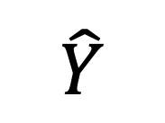
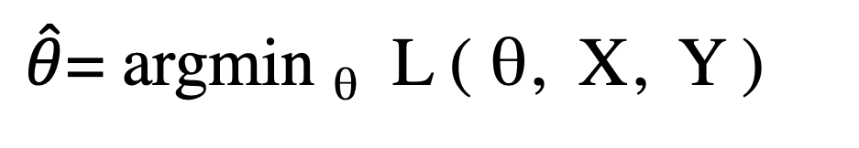
Argmin symmetries
This metafunction has some symmetries:
L+c has same argmin as L
cL has same argmin as L
L², abs(L), L^{1/2} same argmin
log(L) has the same argmin if L isn’t outside its domain
$\hat{θ}$= argmin _{θ} L ( θ, X, Y )
Loss
θ
$$\hat{Y}$$
X
Y

Slide 7
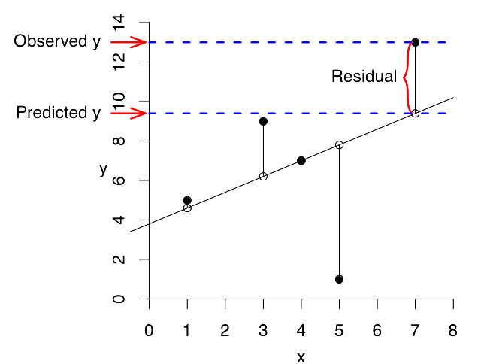
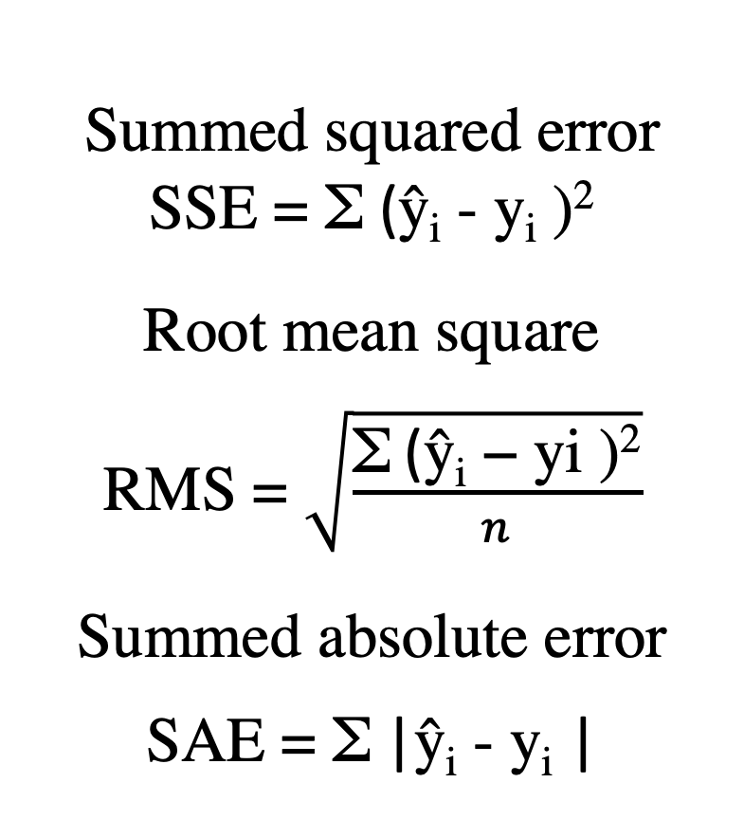
“Regression” = prediction of values
Summed squared error
SSE = Σ (ŷ_{i} - y_{i} )²
^{Root mean square}
RMS = $\sqrt{\frac{\text{Σ}\text{ (}\text{ŷ}\text{i}\text{ − }\text{yi}\text{ )}\text{2}}{n}}$
^{Summed absolute error}
SAE = Σ |ŷ_{i} - y_{i} |

Slide 8
“Regression” = prediction of values
Summed squared error
SSE = Σ (ŷ_{i} - y_{i} )²
^{Summed absolute error}
SAE = Σ |ŷ_{i} - y_{i} |

Slide 9
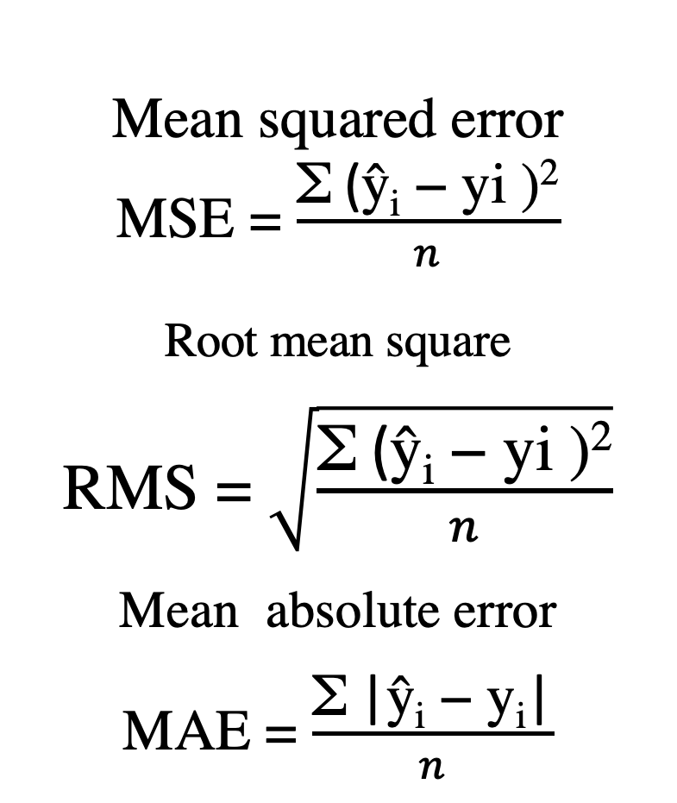
I don’t have to calculate these because of the argmin symmetries. These are monotonic functions of SSE and SAE
Mean squared error
MSE = $\frac{\text{Σ}\text{ (}\text{ŷ}\text{i}\text{ − }\text{yi}\text{ )}\text{2}}{n}$
^{Root mean square}
RMS = $\sqrt{\frac{\text{Σ}\text{ (}\text{ŷ}\text{i}\text{ − }\text{yi}\text{ )}\text{2}}{n}}$
^{Mean absolute error}
MAE = $\frac{\text{Σ} \text{|}\text{ŷ}\text{i}\text{ − }\text{yi}\text{|}}{n}$

Slide 10
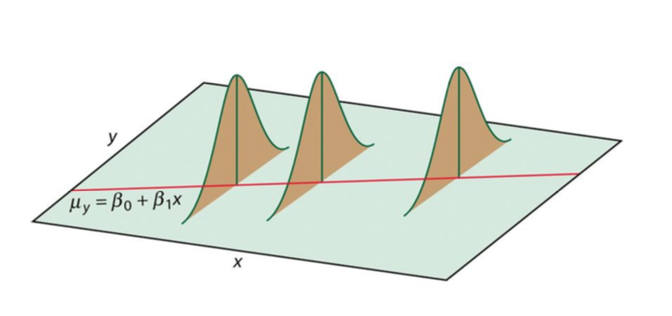
Consequences of sum-squared-error
Minimizing sum-squared error solves the problem of model + additive normally-distributed noise in y where the noise level at each point is the same.
This is often not reasonable; each point often should not get the same weight. Examples?
Weighted (per-datapoint) sums of sum-squared error relax this requirement if you have a theoretical (or empirical) reason to estimate them differently. (Standard error of the mean, anyone?)

Slide 11
Loss function sometimes implies probability
When the objective function looks like (is proportional to) a log-probability function, optimizing it looks a lot like maximum likelihood / maximum a posteriori estimation.
Sum squared errors.. are the log of additive normal error distributions
Certain regularization terms , like w^{T}w, solve the problem with as if the total probability distribution includes normal priors on the components of w. (!!!)
Nice if it’s bounded below
Discontinuities are frowned upon.

Slide 12
Objective function options : choices
The choice of function here sets the balance between small errors and large errors.
Mean Squared Error / sum squared error “L2 loss function”
penalizes large errors much more than small ones
Mean absolute error “L1 loss function”
discontinuous derivative; derivative does not vanish anywhere; all the points pull on the fit whether above or below the fit.
Constraints on parameters, parameter domain…
Cross entropy or expected – log (p)
Useful for completely blind density fitting

Slide 13
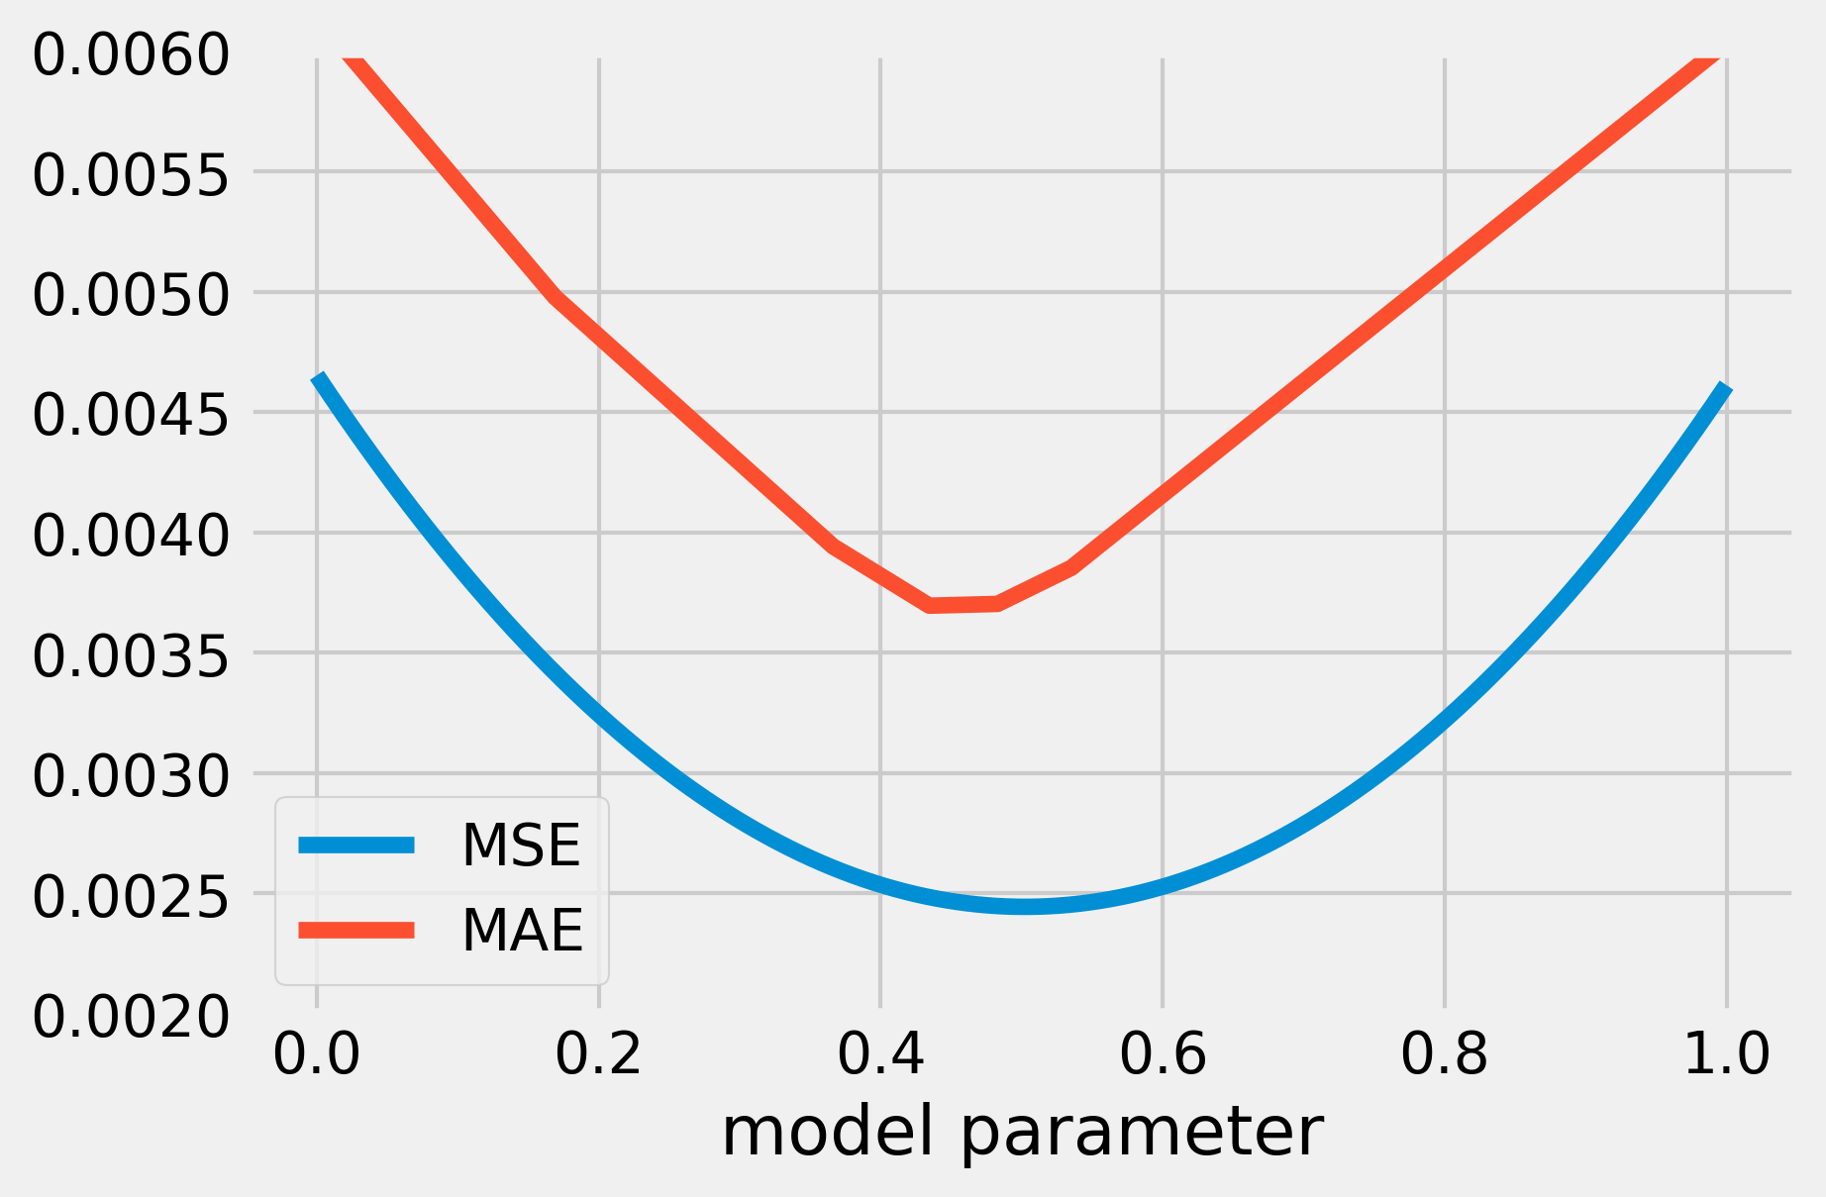
Discontinuities in the slope
of mean absolute error
are hard on optimization.

Slide 14
Contrast L2 and L1
L2 in the residuals gives the same solution as optimizing additive normally distributed errors.
L1 in the residuals give the same solution as optimizing Laplace-distributed errors.
But we can add terms to the loss function that don’t correspond to probability distributions.. these will steer the solution around..

Slide 15
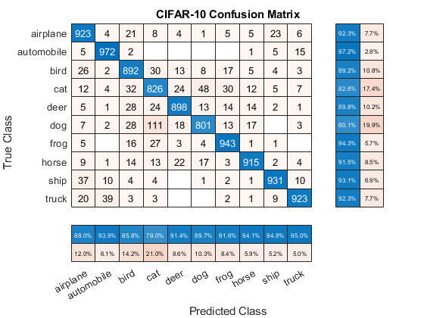
Loss functions for categorical data:
“Accuracy” -- number of correct assignments on the test set
Makes sense to assign penalties to each wrong answer. They can be all the same or they can be different.

Slide 16
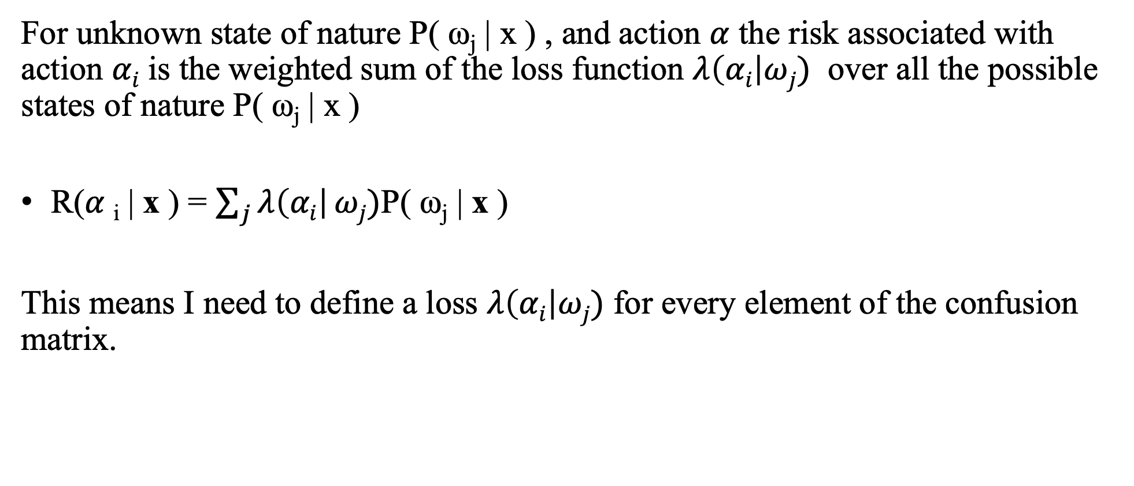
Expected loss
For unknown state of nature $\text{P}\text{( }\text{ωj}\text{ | }\text{x}\text{ )}$ , and action $α$ the risk associated with action $αi$ is the weighted sum of the loss function $λ\left(αi\right|ωj)$ over all the possible states of nature $\text{P}\text{( }\text{ωj}\text{ | }\text{x}\text{ )}$
R($α$_{i} | x ) = $\sum_{j}{λ\left(αi\right|}ωj)\text{P}\text{( }\text{ωj}\text{ | }\text{x}\text{ )}$
This means I need to define a loss $λ\left(αi\right|ωj)$ for every element of the confusion matrix.

Slide 17
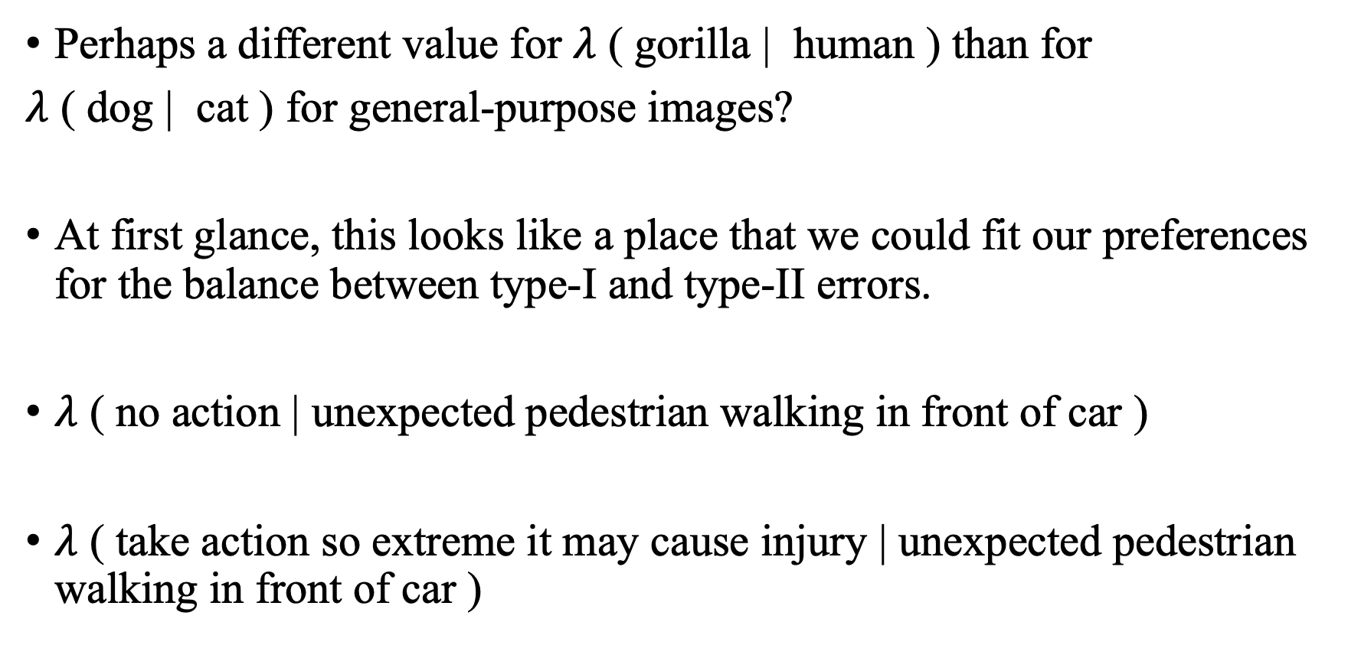
Thoughts on the loss
Perhaps a different value for $λ$ ( gorilla | human ) than for
$λ$ ( dog | cat ) for general-purpose images?
At first glance, this looks like a place that we could fit our preferences for the balance between type-I and type-II errors.
$λ$ ( no action | unexpected pedestrian walking in front of car )
$λ$ ( take action so extreme it may cause injury | unexpected pedestrian walking in front of car )

Slide 18
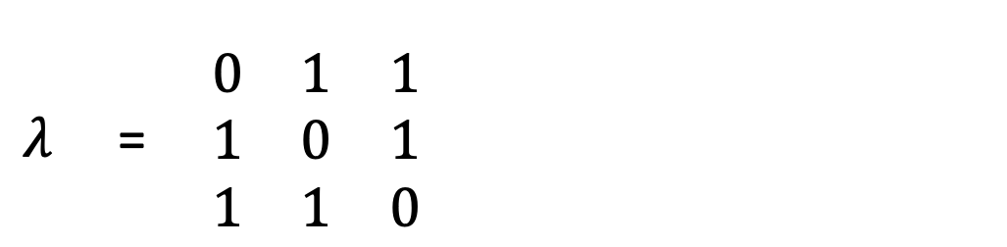
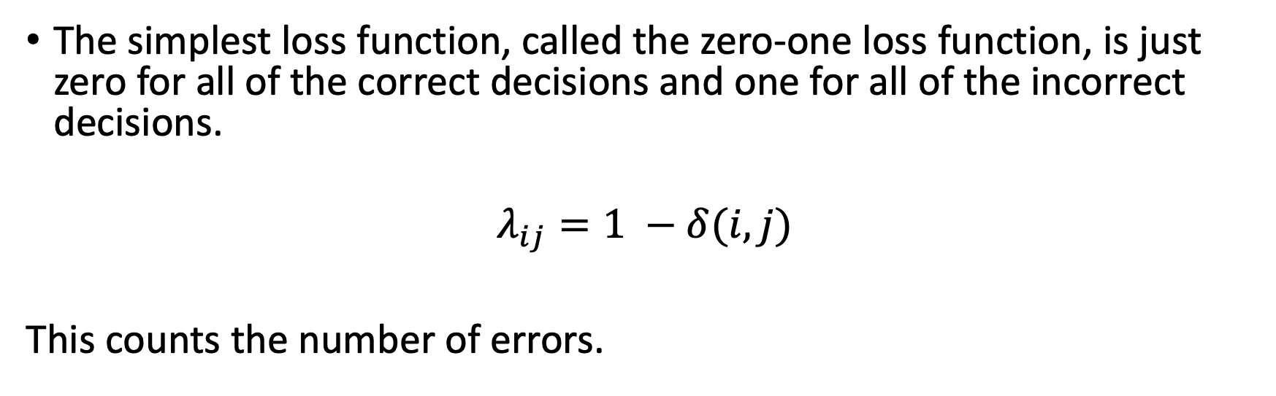
Zero-one loss function
The simplest loss function, called the zero-one loss function, is just zero for all of the correct decisions and one for all of the incorrect decisions.
$$λ_{ij}=1 −δ(i, j)$$
This counts the number of errors.
$λ$ = $\begin{matrix}0 & 1 & 1 \\ 1 & 0 & 1 \\ 1 & 1 & 0\end{matrix}$

Slide 19
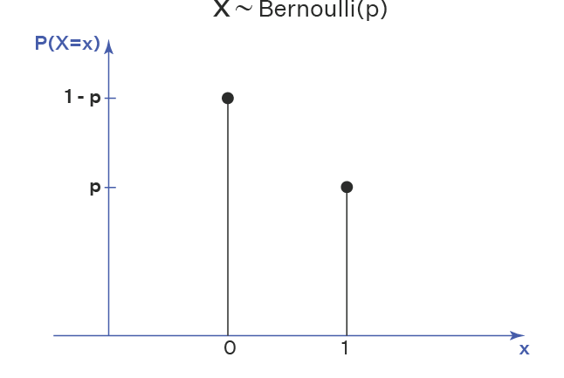
How about the domains?
When estimating probabilities (like mixing ratios) some parameters naturally live in the parameter space of the Bernoulli (or multinomial / categorical distribution)
That is to say, there are a lot of useful parameters out there that are between 0 and 1.
How do we search a space without running out of the domain?
Loss ( min( max(0, x ), 1) ) is not a good choice.
Loss_{CONSTRAINED} = Loss + HUGE ( x> 1) + HUGE ( x < 0)
also not a good choice

Slide 20
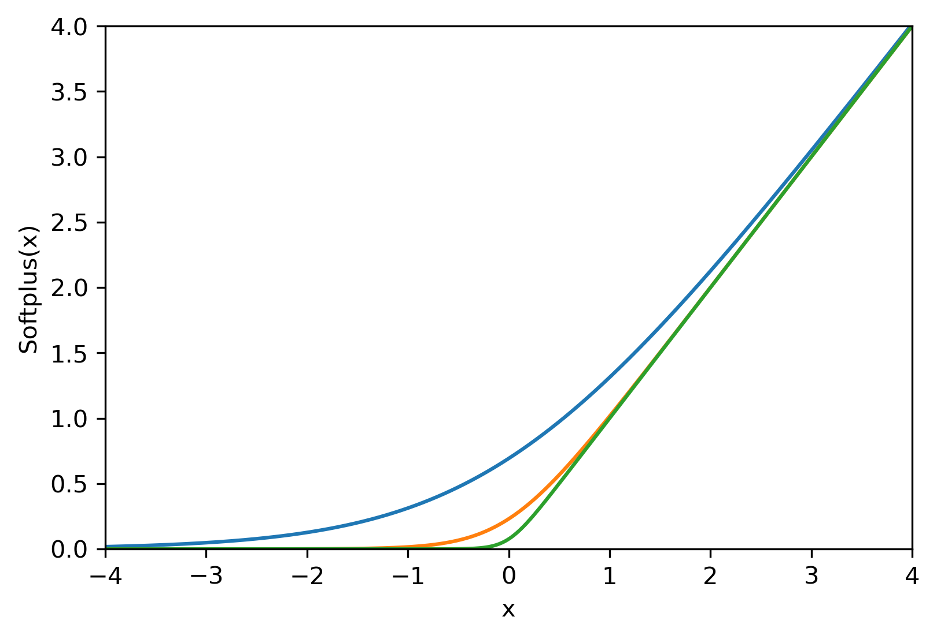

Softplus
$$softplus\left(x\right)=\log\left( 1+\exp\left(x\right)\right)$$
gentler form of max(0, x)

Slide 21
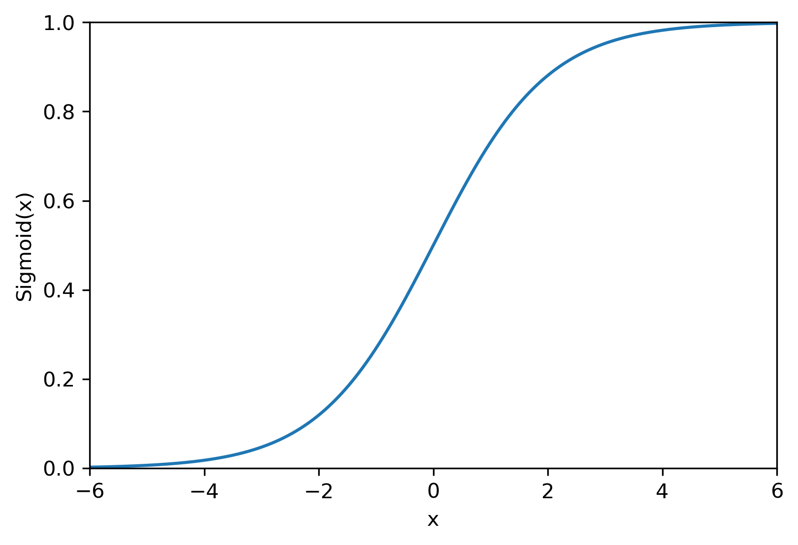
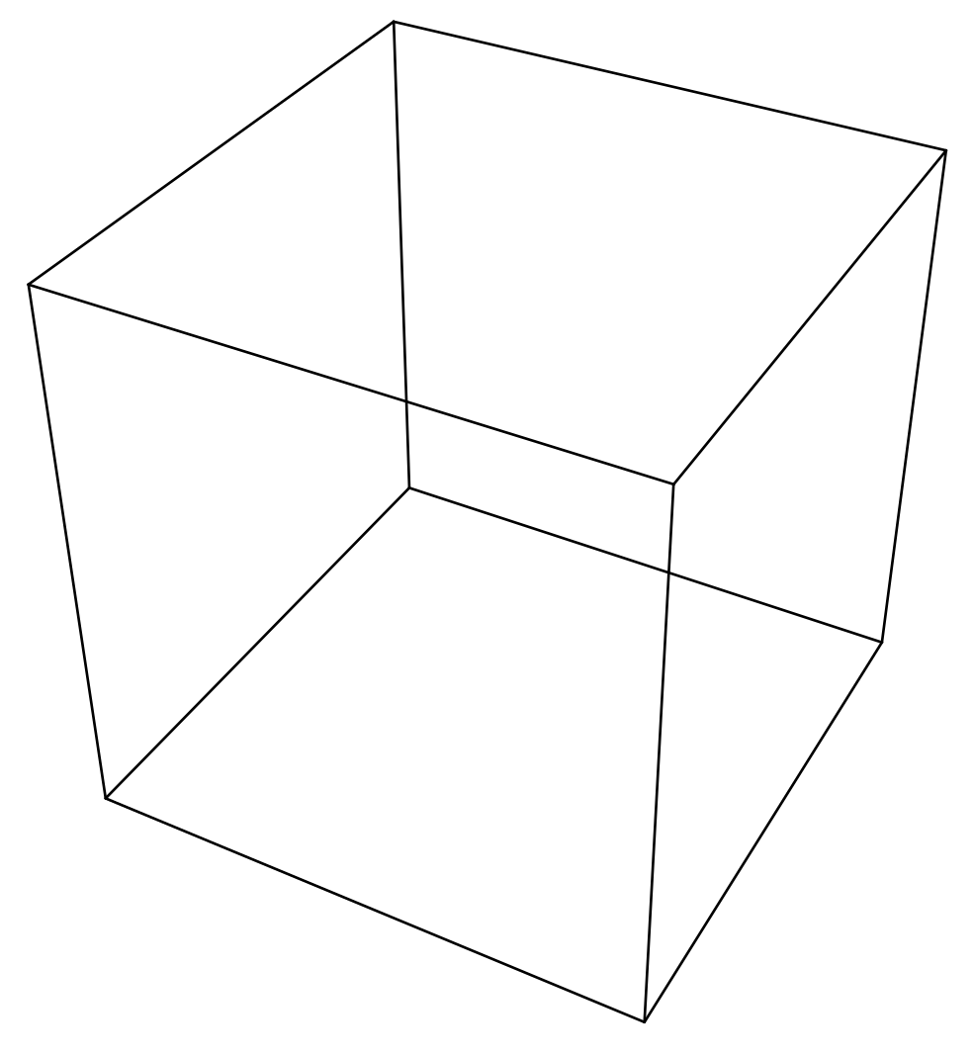

Sigmoid function
$$sigmoid\left(x\right)=\frac{exp\left(x\right)}{1+\exp\left(x\right)}{ }$$
continuous mapping from ℝ to (0,1)
ℝ³

Slide 22
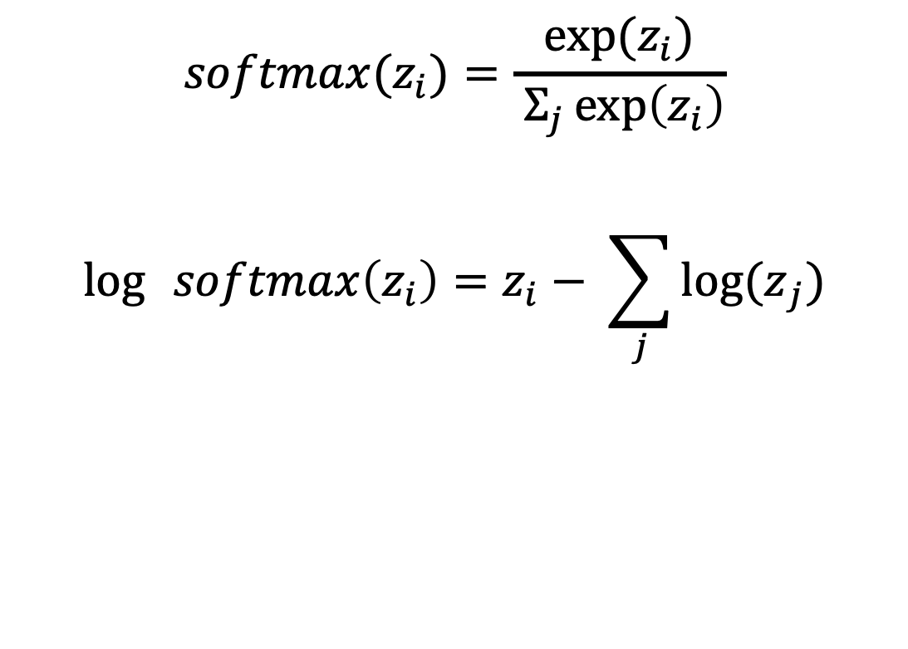
Softmax
$$softmax(z_{i})=\frac{{exp⁡(z}_{i})}{ Σ_{j}\exp\left(z_{i}\right)}$$
$$\log{ }softmax\left(z_{i}\right)=z_{i}− \sum_{j}{{log⁡(z}_{j})}$$

Slide 23
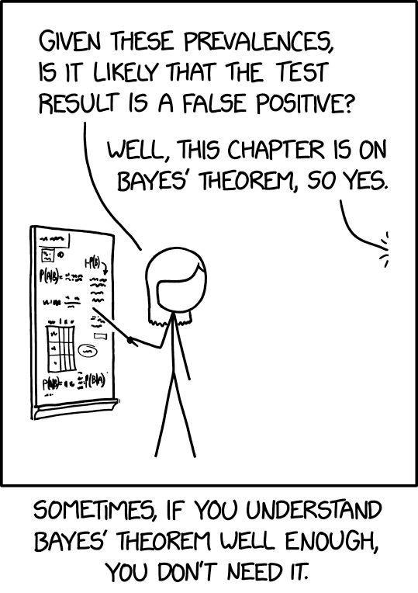
In favorable cases, we can use Bayes’ theorem to estimate our parameters. In less favorable cases, we can do a randomized search for possible parameter values.

Slide 24
Bayesian inference
Event A: unknown state of nature
Event C: experiment
P(A | C ) = P(C|A) P(A) / P(C)
A
C
A∩C

Slide 25
Bayesian inference
Event A: unknown state of nature
Event C: experiment
P(A | C ) = P(C|A) P(A) / P(C)
A
C
“Numerical decisionmaking for grownups”
A∩C

Slide 26
Bayesian inference
Event A: am I infected?
Event C: experiment (test result)
P(A | C ) = P(C|A) P(A) / P(C)
The thing
I want to
know
The thing
the FDA wants
know
C
A
A∩C

Slide 27
Bayesian inference
Event A: unknown state of nature
Event C: experiment
P(A | C ) = P(C|A) P(A) / P(C)
Term with
knowledge
and bias
about A
prior
A
C
Life’s persistent
question
Term that
depends on
experiment
likelihood
Probability
for event that is no longer uncertain
evidence
A∩C

Slide 28
Bayesian inference
Event A: value of parameter
Event C: data
P(A | C ) = P(C|A) P(A) / P(C)
Desired
distribution/
parameter value
posterior
Prior
distribution
for parameter
prior
Doesn’t
matter for
us
evidence
A
C
This is the
likelihood
A∩C

Slide 29
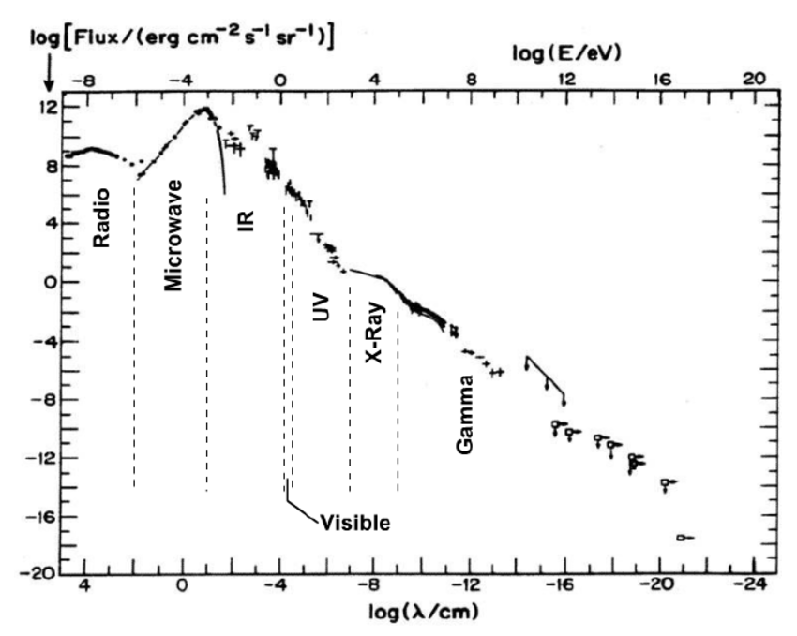
Why do we take logs?
Mathematical convenience; turns multiplication into addition
Dynamic range; floating points only store 15 digits (Anyone tried to calculate 500 Choose 498 on a calculator?)
Numerical precision: probabilities in high-dimensional space run into underflow problems
log-transform is monotonic,
so the location of the optimum
is unperturbed

Slide 30
Bayesian inference
Event A: unknown parameter
Event C: data
log P(A | C ) = log P(C|A) + log P(A) – log P(C)
Desired
parameter distribution
The likelihood
likelihood
Prior distribution
on the parameter
prior
depends only on the data
evidence
posterior
likelihood

Slide 31
Bayesian inference
θ: value of parameter
Y: data
P( θ | Y ) = P(Y|θ) P(θ) / P(Y)
Distribution
to help me
find the
parameter value
posterior
This is the
likelihood
likelihood
Doesn’t
matter for
us
evidence
A
C
Prior
distribution
for parameter
prior
A∩C

Slide 32
Where does the prior come from?
In some cases, there will be a correspondence between our objective function and the solution to a Bayesian inference problem.
If we were doing this the other way, taking inference as our approach to problem-solving, we would choose prior distributions either from
Prior research into the values of the parameters (common in physical sciences)
Symmetries of the problem (geometry) that makes certain classes of solution equivalent to certain other classes of solution.
Some of these priors don’t have finite integrals… “improper priors” usually the likelihood forces the product to converge; if it doesn’t, we have to take the limit of a ratio of divergent integrals.
Sometimes, the priors are chosen because they are easy to calculate
(good and bad)

Slide 33
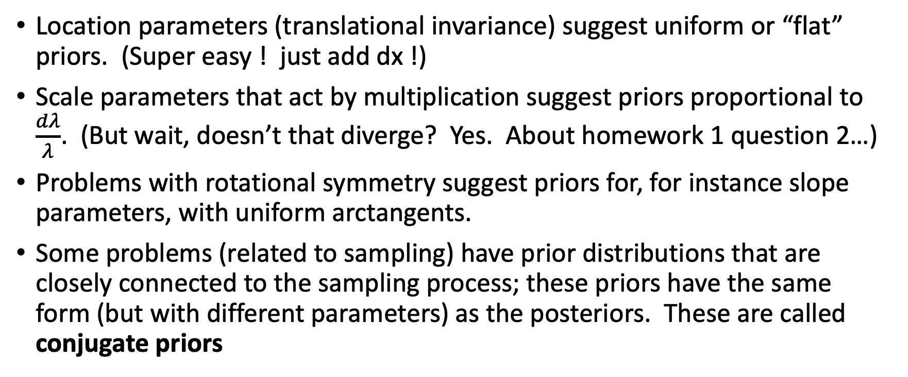
Choices
Location parameters (translational invariance) suggest uniform or “flat” priors. (Super easy ! just add dx !)
Scale parameters that act by multiplication suggest priors proportional to $\frac{dλ}{λ}$. (But wait, doesn’t that diverge? Yes. About homework 1 question 2…)
Problems with rotational symmetry suggest priors for, for instance slope parameters, with uniform arctangents.
Some problems (related to sampling) have prior distributions that are closely connected to the sampling process; these priors have the same form (but with different parameters) as the posteriors. These are called conjugate priors

Slide 34
Homework guidelines
No particular tools are required (python, R, javascript..) but we’re better able to help you in python and R.
Graphs are expected to a medium-high standard. Labels, units everywhere where needed. Caption-like explanations of graphs preferred.
Upload PDFs of answers to Canvas. Separately upload code (to a low standard) that you used to solve the homework. We probably won’t look at the code.
HW1, problem 2 needs to be revised to confidence bounds for the magical detector with sensitivity everywhere from x=0 to x=infinity.

